Slide 1
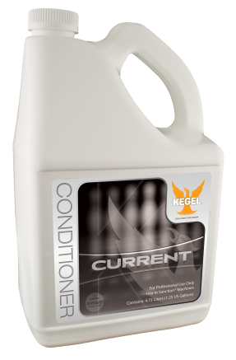
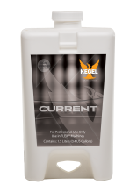
Current features a new polymer which extends the conditioner into longer strands as opposed to droplets. This allows the conditioner to maintain a better structure which shows up on the lane with more predictable ball motion.
Used alone, Current is the perfect option between Fire and Ice when it comes to slickness. Current was also designed to be compatible with Fire and Ice and can be used by FLEX owners to create even more options.
156-8175
Shipping Weight: 40 lbs. (18.1 kg)
One Container: 1.25 gallon (4.73 liters)
Packaging:
4 containers per case
5 gallons (19 liters)
156-8175C
Shipping Weight: 38.5 lbs (17.4 kg)
One cartridge: 0.4 gallons (1.5 liters)
Packaging:
12 cartridges per case
4.75 gallons (18 liters)
Technical Features / Chemical Specifications
Viscosity: 52.0 cps
Surface Tension: 23.3 dyn/cm
Features
For Sanction Technology™ Lane Machines
Elemental Series Durability
Optimized for synergy with Fire and Ice
Consistent, predictable ball motion
Even scoring pace
Back-ends stay crisp
Driest Carrydown of any Conditioner to date
Pinsetter and House Ball Friendly
Easy to clean
DISTRIBUTORLOGO
DISTRIBUTOR Co.
444-345-678
www@gty.com / www.gty.com

